Slide 2
Previously in IMM120
Everyone got everything right on the minute survey!
Review:
push / pop
SNAKE!!

Slide 3
Notes:
So how do we move forward

Slide 4
Notes:
Now we have 11

Slide 5
unshift
pop
Notes:
What about when you eat food?

Slide 6
(yum)
push

Slide 7
Loops
I recommend turning off auto-update

Slide 8
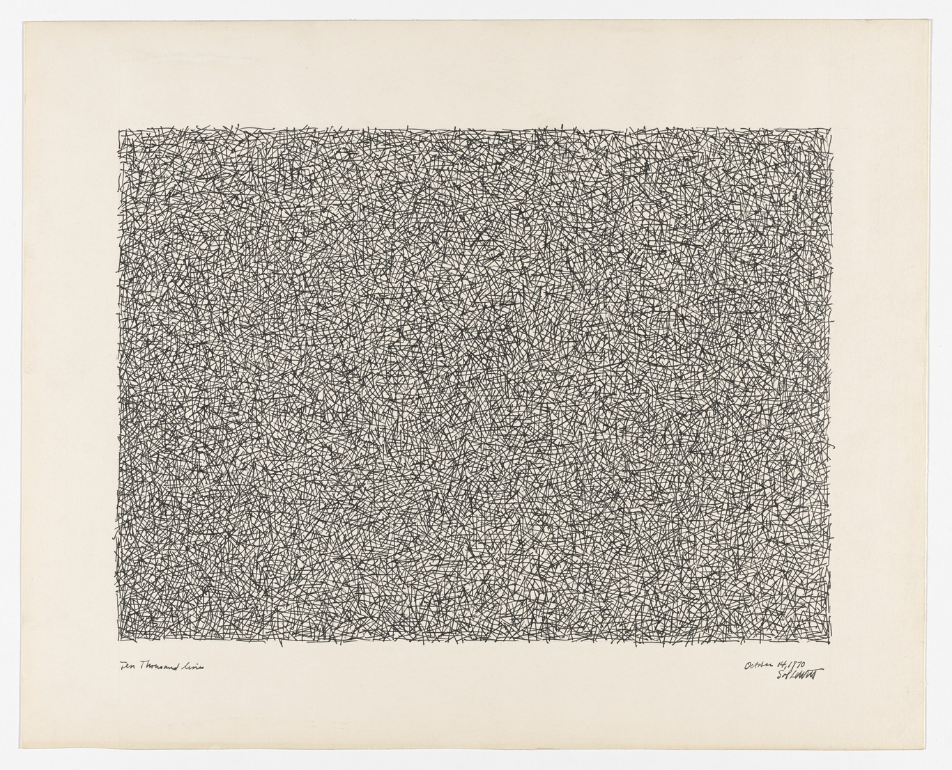

Slide 9
The While Loop
- line of code -
if
- line of code -
- line of code -
- line of code -
Notes:
If vs While example (if < 300) x += 1

Slide 10
The While Loop
- line of code -
while
This is the difference.
After the code in the brackets has been run,
a while loop goes back to the start and
checks its condition again.
The code repeats while the condition is true.
- line of code -
- line of code -
- line of code -
Notes:
If vs While example (if < 300) x += 1

Slide 11
Using Loops: Patterns
Set a starting point
Set an end point
Change by the gap you want
var x = 100;
while (x < 300) {
ellipse(x, 300, 100);
x += 10;
}
Notes:
If vs While with echo

Slide 12
Using Loops: Counting
Set a starting point
Set an end point
Add one
var count = 1;
while (count <= 300) {
line(/* random */);
count ++;
}
Notes:
Random lines example

Slide 14
Using Loops: Arrays
Loops are very commonly used for arrays in two ways:
Set a starting point
Set an end point
Add one
var index = 0;
while (index < arr.length) {
arr[index];
index ++;
}
Notes:
REMEMBER ZERO

Slide 15
Using Loops: Arrays
You can use loops to fill arrays as well (as discussed last week).
Notes:
Let’s pull up the example from last week.

Slide 16
“For” Loops
There’s a more concise way to write a counting loop:
var index = 0;
while (index < arr.length) {
arr[index];
index ++;
}
for (var i = 0; i < arr.length; i++) {
arr[i];
}
Notes:
All loops in all the projects

Slide 17
Sol Wall Drawings
http://solvingsol.com/solutions/

Slide 18
Filling Shapes with Patterns

Slide 19
Filling Shapes with Patterns

Slide 20
Homework
Submit your work today

Slide 21
Minute Survey: Future Topics
Also, The Deep End: where I can explain how things work

